Slide 1

Stereo Vision, Stereoscopy & Virtual Reality
By
Aruna Ishara Gamage
Lecturer, Software Engineering/Multimedia, Department of Computer Science & Software Engineering, Faculty of Computing, SLIIT
ishara.g@sliit.lk

Slide 2
Virtual Reality
What makes the sense of realism(යථාර්ථවාදය)?
“Feeling of the existence of a non-existing object or environment”

Slide 3

Stereo Vision
A large part of our brain is devoted to understanding visual cues.
Depth information can help us to understand spatial relationships in a complex data set

Slide 4
Binocular Vision
Our two eyes produce a single image in the brain: a “Cyclopean image”
Creatures with binocular vision generally have forward-facing eyes that move together

Slide 5


Binocular Vision
Animals that tend to get chased find it useful to have a panoramic view of the world(හඹා යෑමට නැඹුරු වන සතුන් ලෝකය පිළිබඳ පරිදර්ශනීය දෘෂ්ටියක් තිබීම ප්‍රයෝජනවත් වේ) – A rabbits have almost 360 field of vision
Animals that do the chasing need to be able to judge distance to their prey accurately(හඹා යාමේ යෙදෙන සතුන්ට තම ගොදුරට ඇති දුර නිවැරදිව විනිශ්චය කිරීමට හැකියාව තිබිය යුතුය)
– Predators tend to move fast, if they are inaccurate in distance estimates they will starve or injure themselves
Tree apes need to be able to judge the distance to the next branch accurately

Slide 6
IPD: (Human) Inter-Pupillary Distance
Need separation between our eyes to see in stereo.(ස්ටීරියෝ වලින් බැලීමට අපට අපගේ ඇස් අතර වෙන්වීමක් අවශ්‍යයි.)
Different sources provide different values for this number.
Mean adult IPD is around 63 mm.
The vast majority of adults have IPDs in the range 50–75 mm.
The wider range of 45–80 mm is likely to include (almost) all adults
Minimum IPD for children (down to five years old) is
around 40 mm

Slide 7
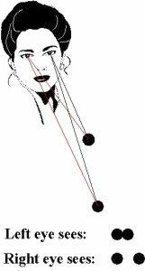
Binocular Vision
Our eyes are separated by about 6.5 cm so our retinas each get a slightly different view of the world.
The right actually sees more distance between the objects. (as well as slightly different parts of the surfaces)

Slide 8
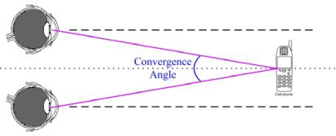
Binocular Vision
Components of Stereo Vision:
CONVERGENCE of the eyes (achieved by the eye muscles)
ACCOMODATION (focus) of the lens to provide sharp images on the retinas

Slide 9
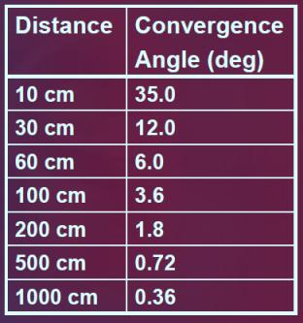
Binocular Vision
The following table shows convergence angles for different distances given for 6.3 cm IPD.
Convergence Angle is Inversely Proportional to Stereo Effect.

Slide 10
Seeing in 3D
If retinal(දෘෂ්ටි විතානය) images are very different the eyes try to adjust to make then more similar.
Once the brain has fused the images into one object, the small differences on the retina are interpreted as the 3rd Dimension.
Our brain interprets the two views as a scene with depth and does a great job of judging distances from us, up to about 20 feet. (diminishes but works up to ~200 m)(අපගේ මොළය මෙම දර්ශන දෙක ගැඹුරින් දර්ශනයක් ලෙස අර්ථකථනය කරන අතර අඩි 20 ක් පමණ දුරින් අපෙන් දුර විනිශ්චය කිරීමේ විශාල කාර්යයක් කරයි. (අඩු නමුත් m 200 m දක්වා ක්‍රියා කරයි)

Slide 11
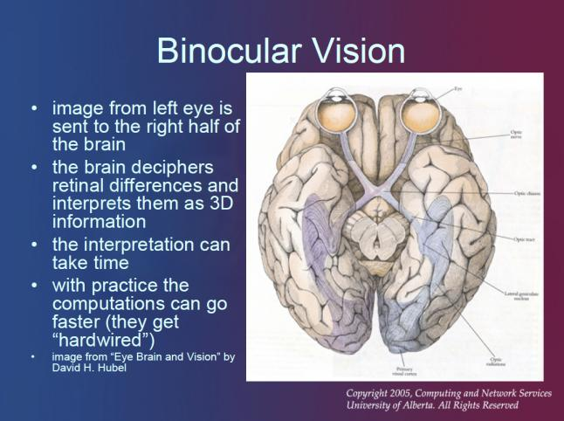
Seeing in 3D

Slide 12
Non-Stereo Depth Cues Monocular cues
Occlusion – near objects block the view of distant objects.
Apparent size – if two objects are actually the same size, but one appears smaller, then the small one is farther away than the larger.
Motion parallax – near objects appear move faster than distant objects.
Perspective – parallel lines converge in the distance(සමාන්තර රේඛා දුරින් අභිසාරී වේ).

Slide 13
Non-Stereo Depth Cues Monocular cues
Texture – becomes finer(සිහින්) with the distance.
Colour change – colours become more blue with the distance.
Haze – objects become fuzzy with the distance.
Accommodation – our brain knows how hard our eyes are working to provide continues focus.

Slide 14
Stereoscopy
A technique to create the illusion of depth in a photograph, movie, or other two-dimensional image.(ඡායාරූපයක, චිත්‍රපටයක හෝ වෙනත් ද්විමාන රූපවල ගැඹුර පිළිබඳ මිත්‍යාව නිර්මාණය කිරීමේ තාක්‍ෂණයකි.)
Need to present a slightly(තරමක්) different image to each eye.
Our brain interprets the two views as a scene with depth and does a great job of judging distances from us, up to about 20 feet. (diminishes but works up to ~200 m).
Stereoscopic Viewer invented by Sir Charles Wheatstone in
1838.

Slide 15
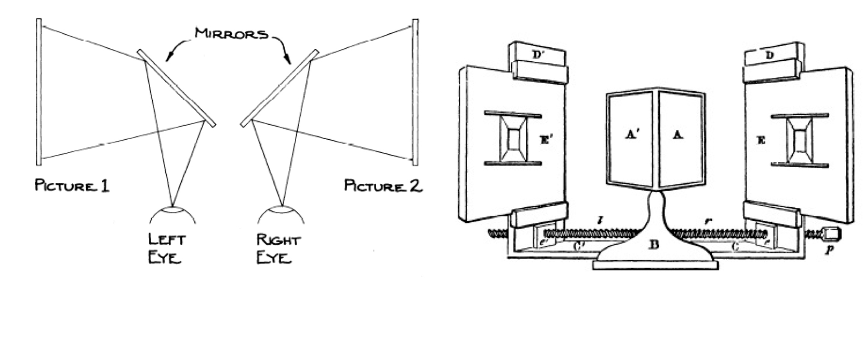
Stereoscopy
Stereoscopic Viewer by Sir Charles Wheatstone (1838)
- Note: No PHOTOGRAPHY yet!

Slide 16
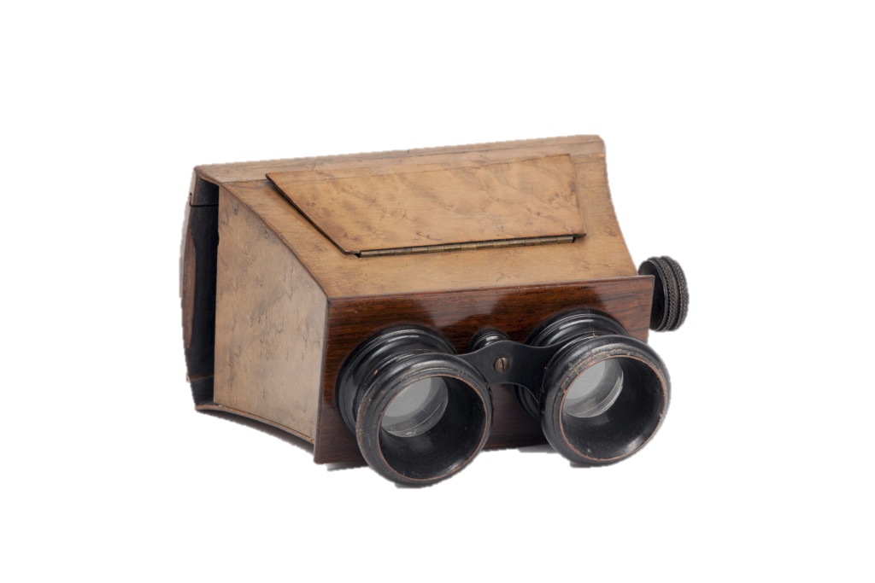
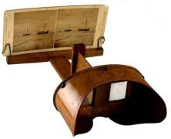
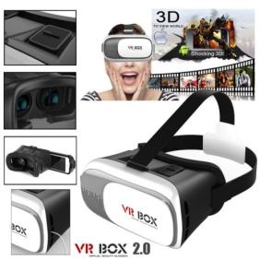
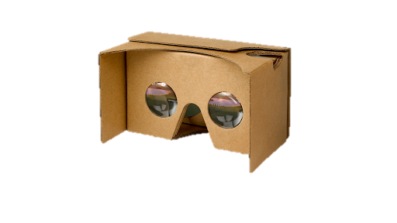
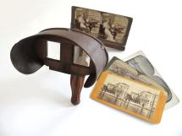
Stereoscopy
Stereoscopic Viewer – Upgraded (1905 ~ 2000’s)

Slide 17
Stereoscopy
• To create depth perception in the brain provide to the eyes of the viewer with two different images.
• Two perspectives of the same object.
• Minor deviation similar to the perspectives that both eyes naturally receive in binocular vision.

Slide 18
Stereoscopy: a simple test?
• Hold a pencil in front of your nose and look into the distance.
• Do you see 2 pencils?
• Some people don’t see 2 pencils because their brains suppress information from one eye.
• The suppressed eye can shift from left to right.
• There might be permanent suppression of one eye.
• people with one eye suppressed won’t be able to see in 3D.

Slide 19
Cross-eyed Stereo
• Look at the following stereo image pair by slightly crossing your eyes.
• Left eye sees the right image and right eye sees
the left image

Slide 20
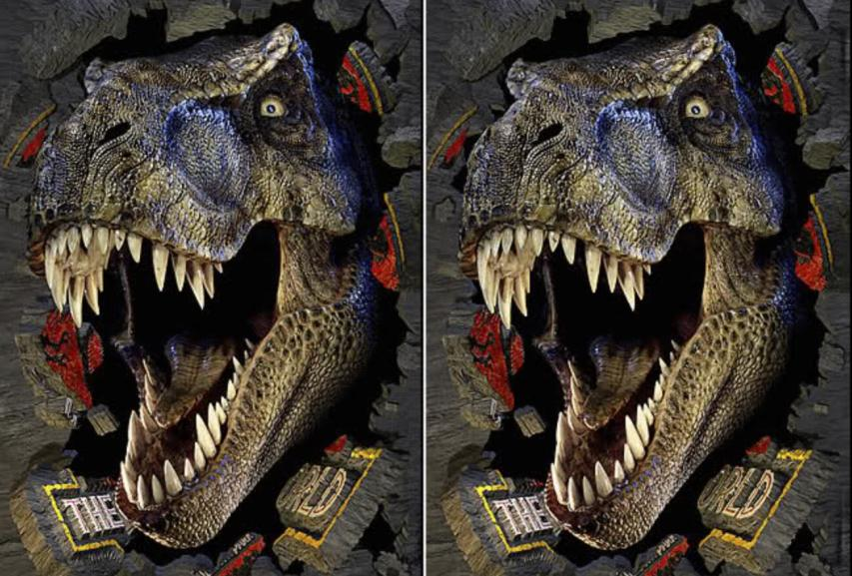
Cross-eyed Stereo

Slide 21
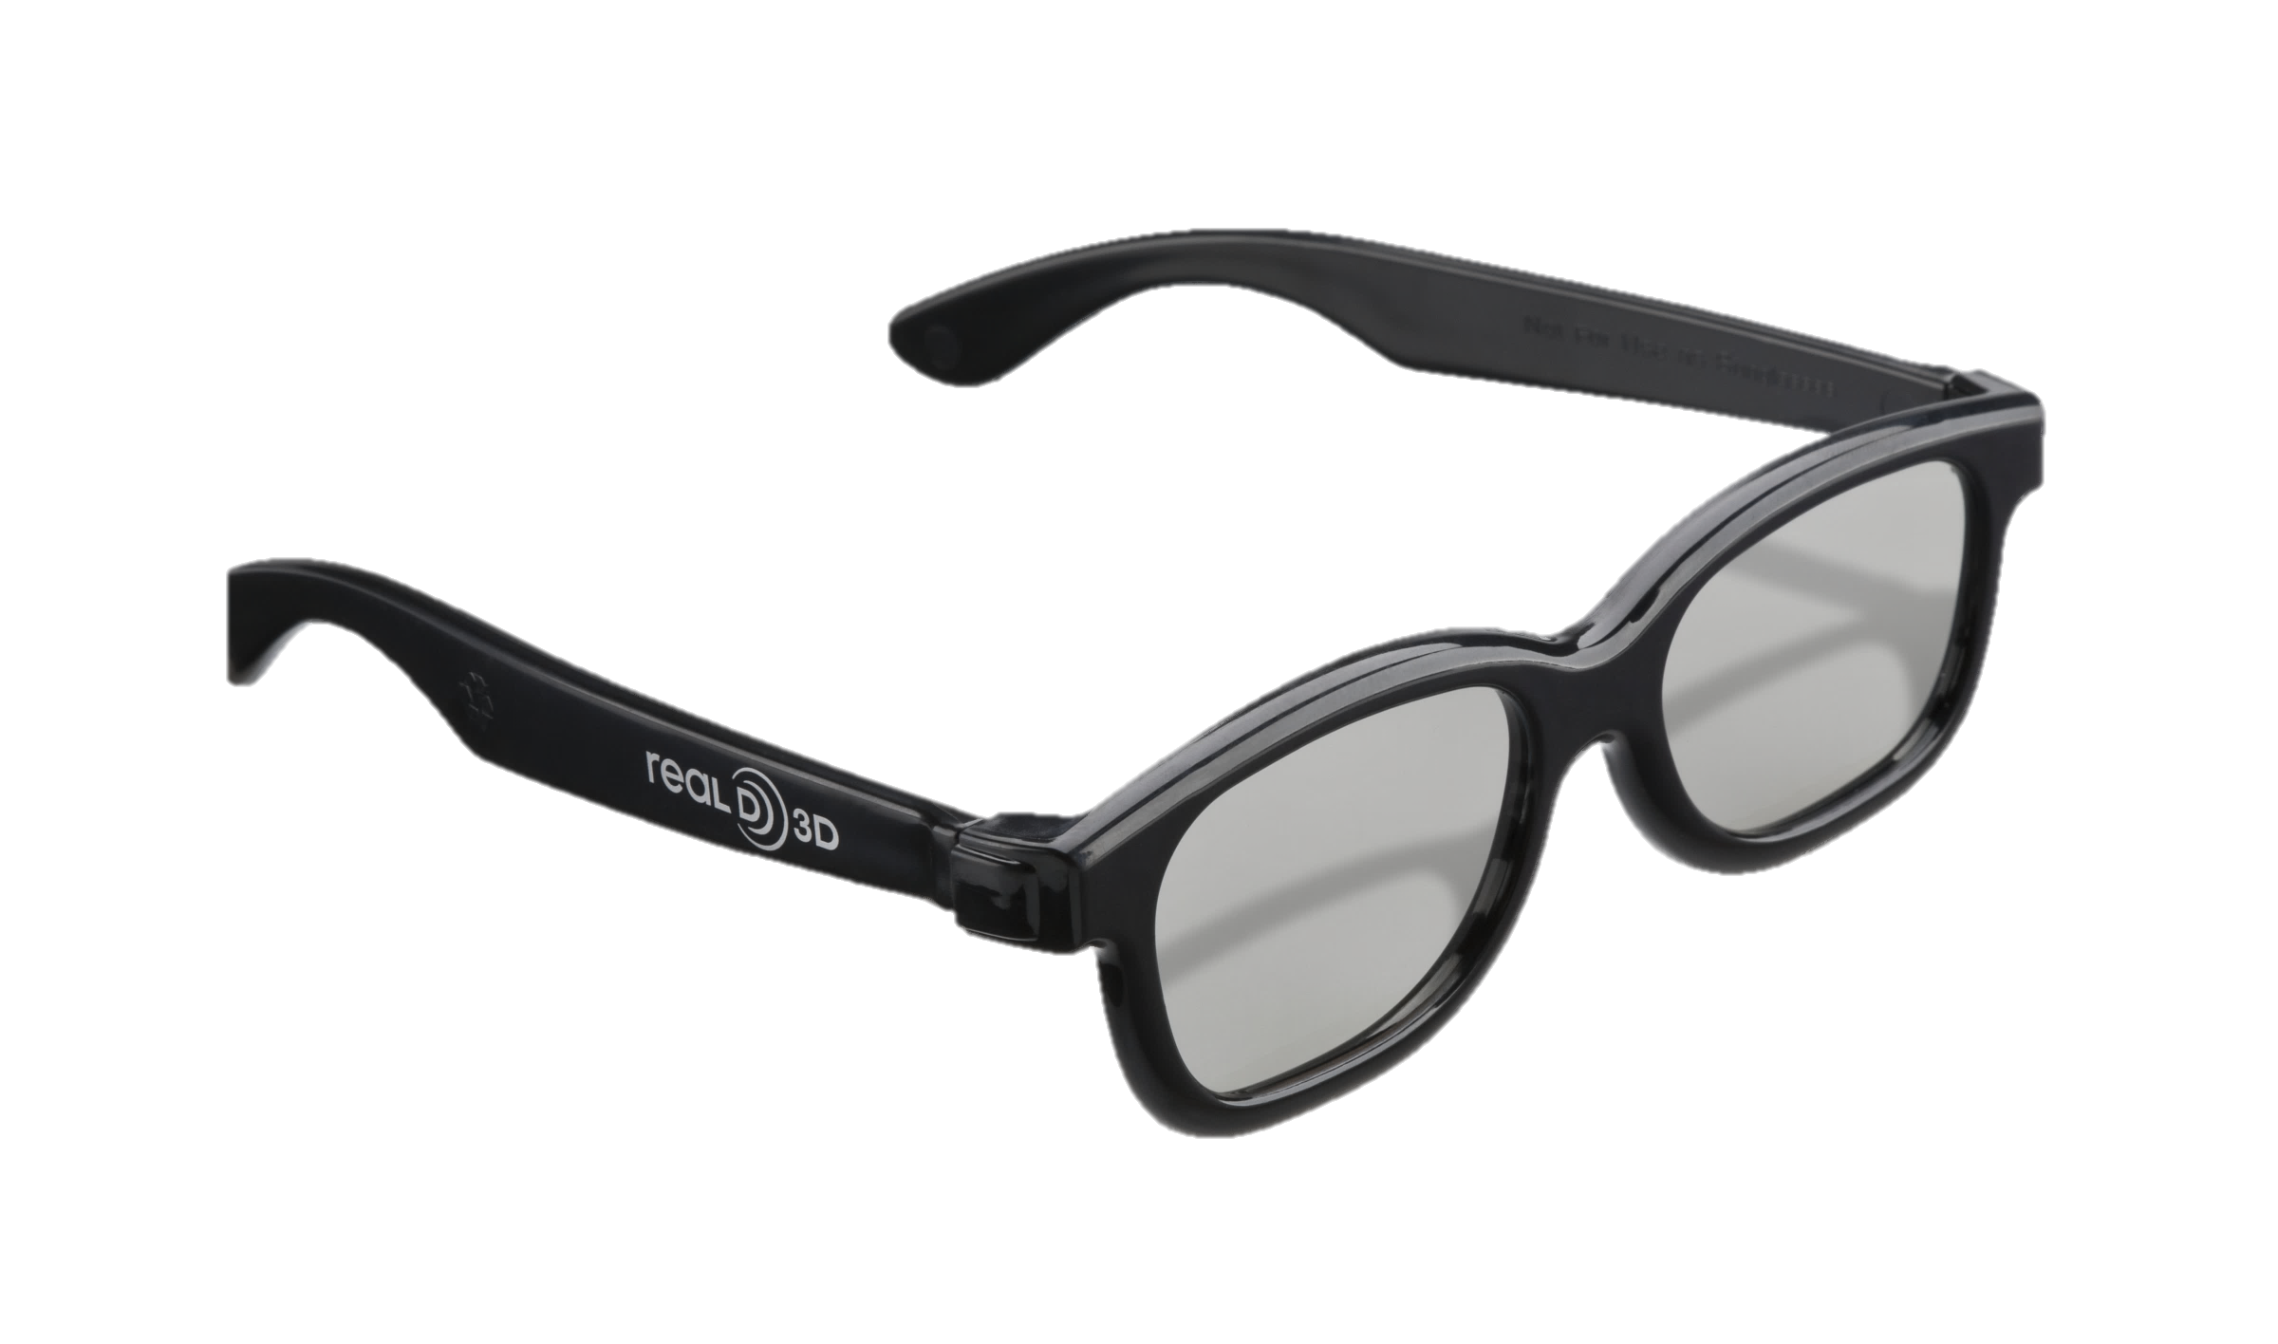
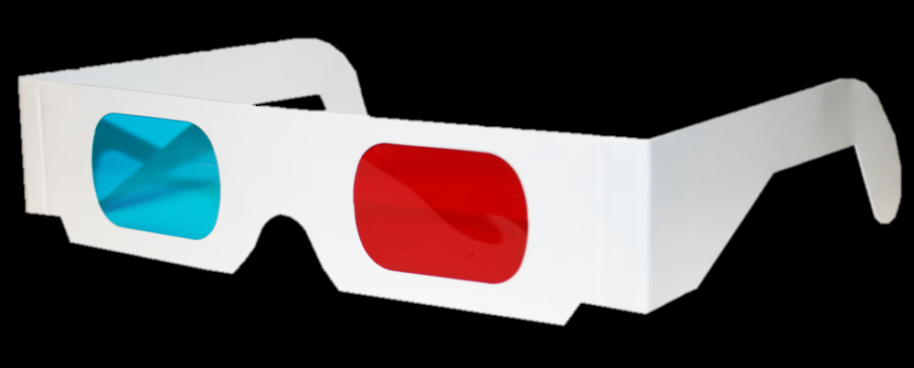
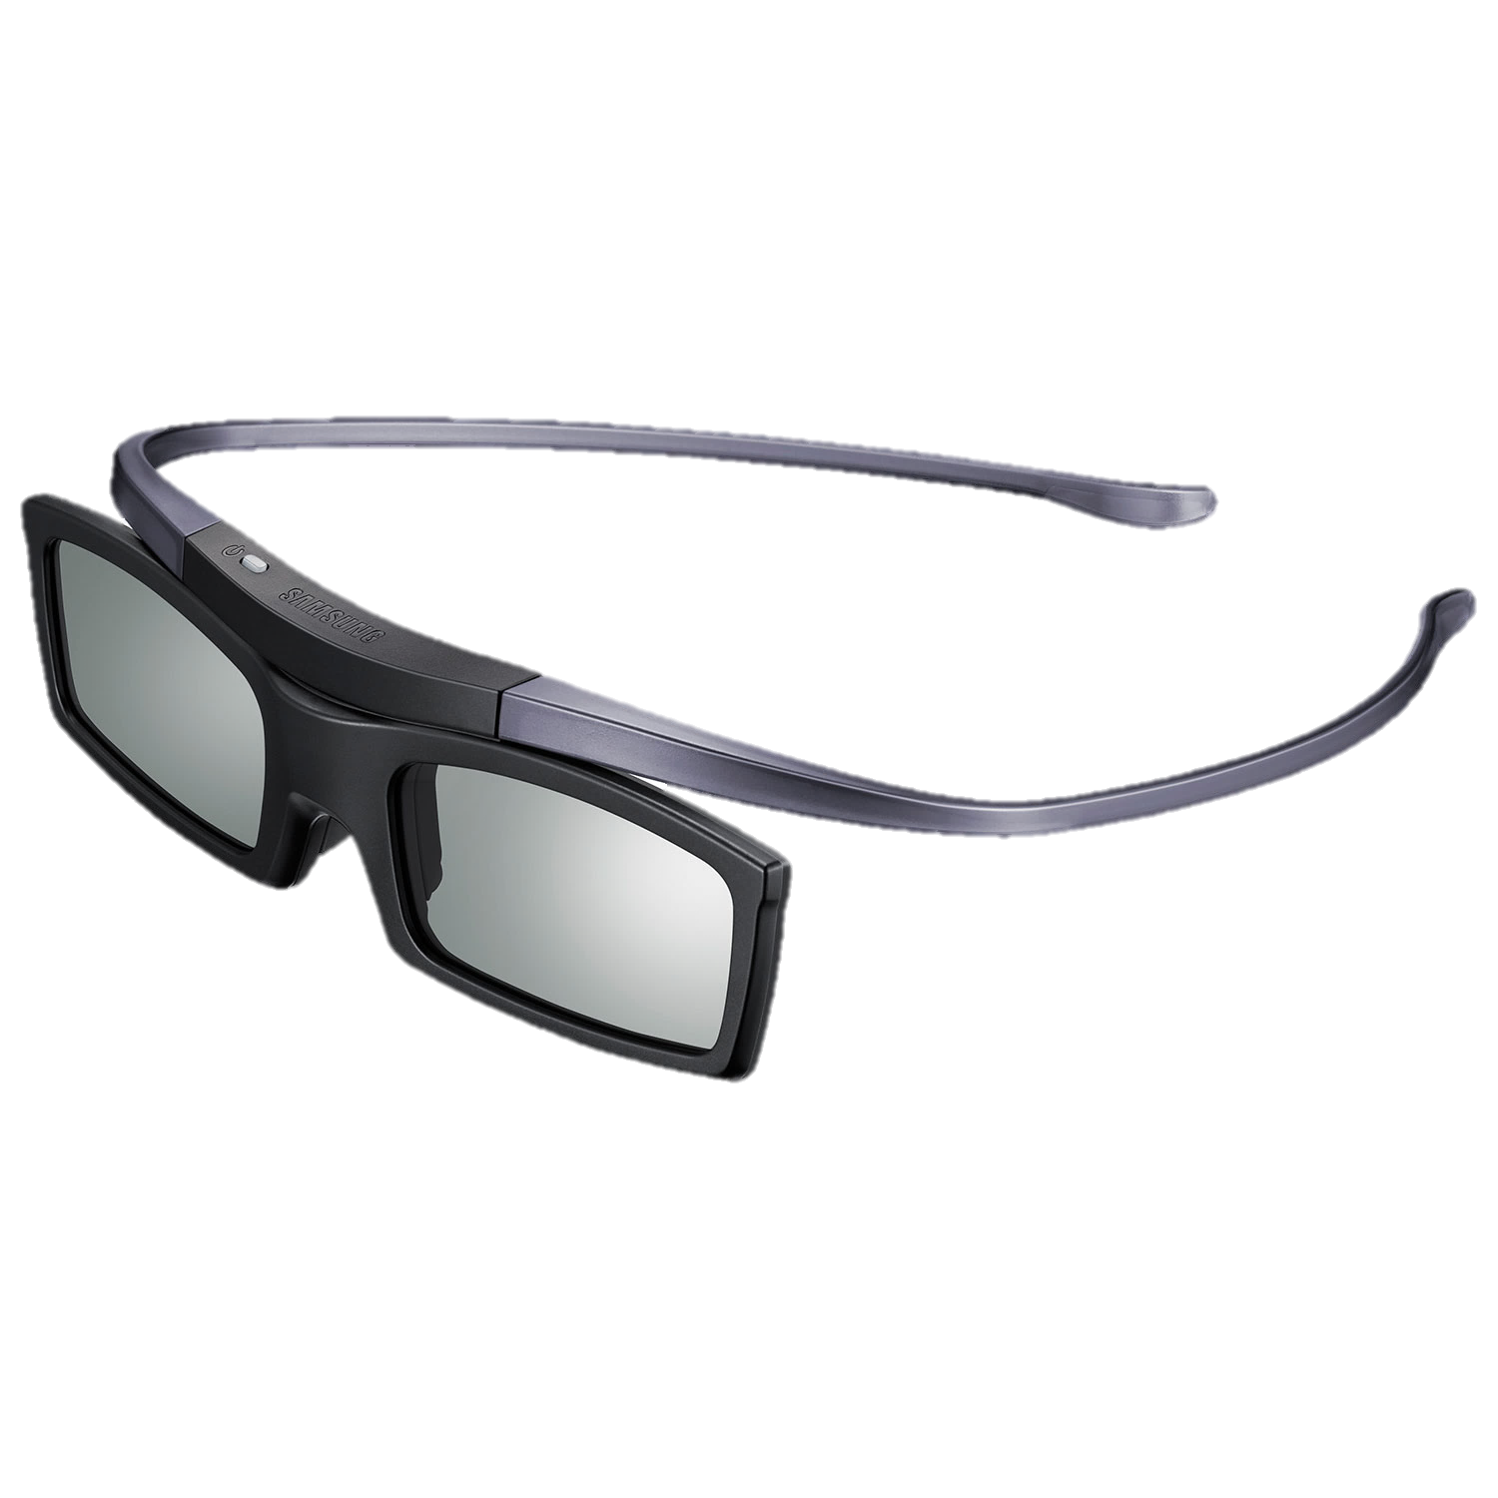
Stereoscopic 3D Video Content
A common term: 3D movies!
Need special eye ware (3D glasses)
Active Stereo
(battery Powered) Chemical Shutter Glasses
Passive Stereo
Anaglyph 3D
Polarized 3D
Linear Polarized
Circular Polarized
Need special projection systems.
Need to be able to project frames alternatively,
representing Left-eye and Right-eye image components.

Slide 22
3D Movies: Feeling of Realism
Feeling of realism is generated by:
Creating a visual illusion of depth by cheating our brain.
Calibrated surround sound effects representing the visual environment.
Making us believe that we are one with what we see… or… what we see actually exist in front of us!
Which is something that
really isn’t there!

Slide 23
Virtual Reality
Virtual Reality (VR) is the illusion of a
Three-Dimensional
Interactive,
Computer-Generated Reality where
Sight
Sound, and sometimes even
Touch
are simulated to create
Pictures
Sounds,
and objects that actually seen and feel real.

Slide 24
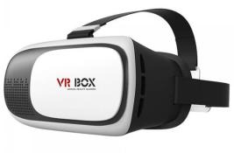
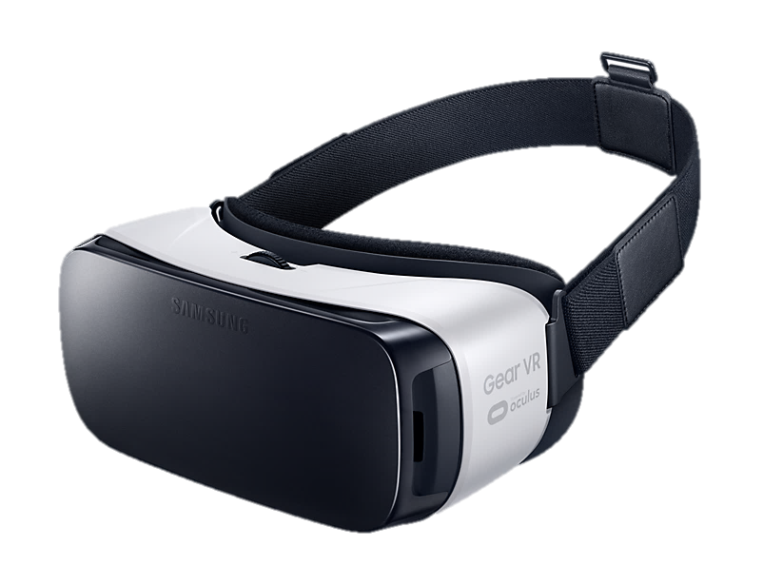
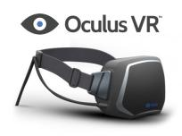
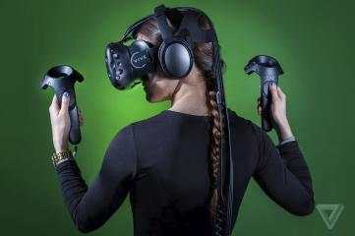
VR Headsets
Cost Effective (Budget) Solutions
Google Cardboard
VR-Box
High End Solutions
Samsung Gear VR
Oculus Rift
HTC Vive
Remember, all products use the same basic,
simple elements to bring in the Virtual Reality.
Only the technological ways of presenting the
Visual content is different.

Slide 25
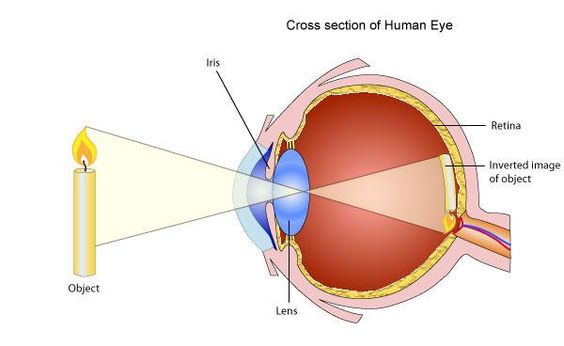
VR Headsets: How they work?

Slide 26
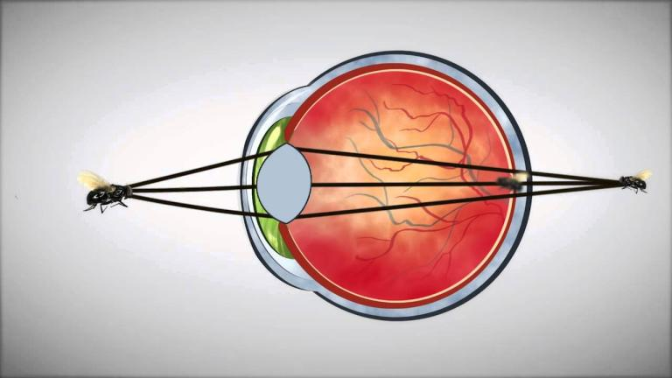
VR Headsets: How they work?

Slide 27
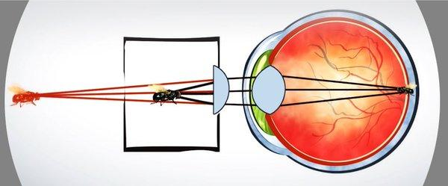
VR Headsets: How they work?

Slide 28
VR Headsets: How they work?
Functionality of the VR Special lenses
Correct the angle of light that is coming into eye and make a forced perspective of the object being farther away than it really is.

Slide 29
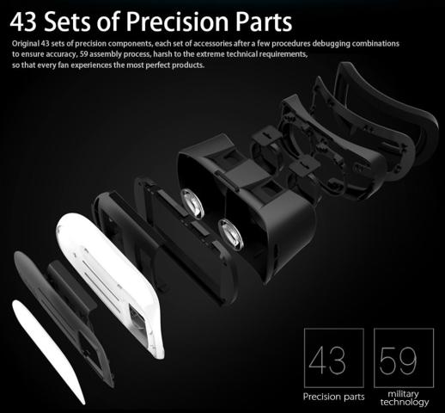
VR Box – Component Breakdown

Slide 30
Virtual Reality: Major Concepts
VR must allow the user to view the environment from any point and at any angle. (360 degree view)
VR must allow the user to interact with objects in the environment.

Slide 31
Again - Virtual Reality – Concept Baseline
What makes the sense of realism?
“Feeling of the existence of a
non-existing object or environment”

Slide 32
Any Questions?
Aruna Ishara Gamage
Lecturer, Software Engineering/Multimedia, Department of Computer Science & Software Engineering, Faculty of Computing,
SLIIT
ishara.g@sliit.lk
071 44 38 449

